Slide 1
rPET Plastic Extruder
Chemical Engineering 01
The Little Engineers That Could
Notes:
Chemical Engineering Group #1 –

Slide 2
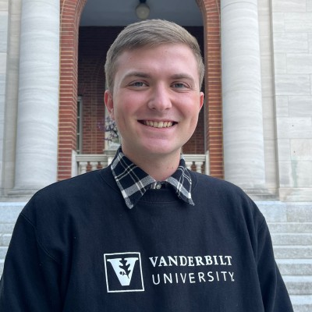
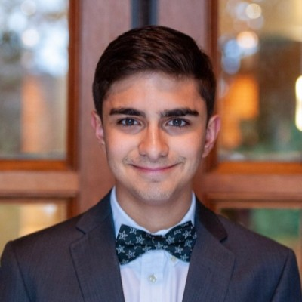
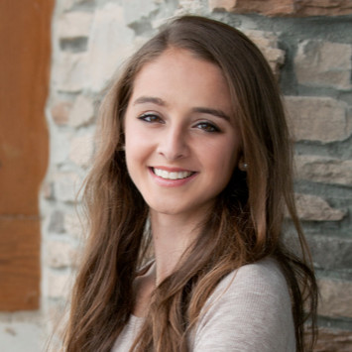
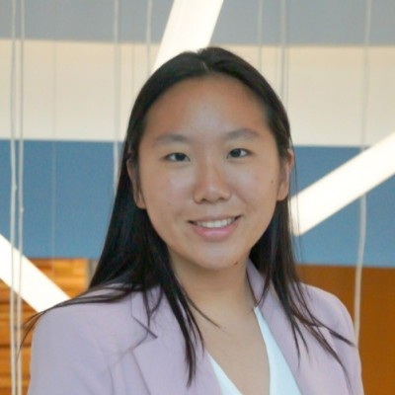
Team Members
Blake Christiansen
ChemE, Material Science
Sam Leville
ChemE, Material Science
Melanie Marszal
ChemE, Computer Science
Amy Pang
ChemE, Material Science

Slide 3
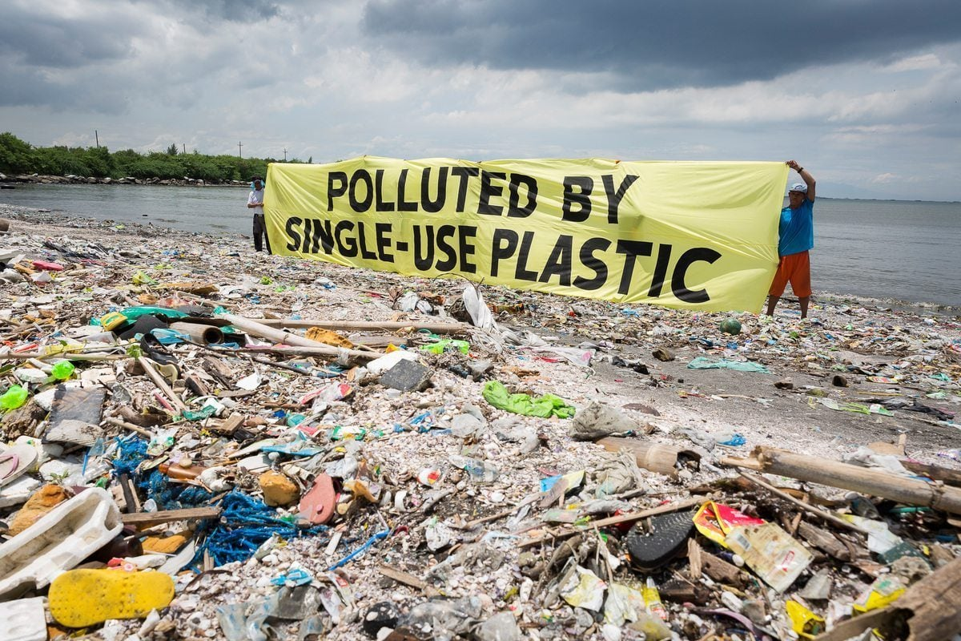
Project Overview
Background
Rising plastic production and consumption
Attainable and impactful solutions
https://www2.deloitte.com/us/en/pages/energy-and-resources/articles/the-changing-single-use-plastics-landscape.htm
https://www.greenpeace.org/usa/oceans/preventing-plastic-pollution/l
Notes:
As we all know, single use plastic consumption is one of the greatest problems our generation faces.
Polyethylene terephthalate – what most soda and sports drinks bottles made of
Rise in single use plastic – attributes to great rise in pollution, climate change, and GHG
Analysis from deloitte – three long term sustainable options for chemical companies: consider alternative sourcing opportunities, improved recycling technologies, working with value chain to create a circular economy

Slide 4
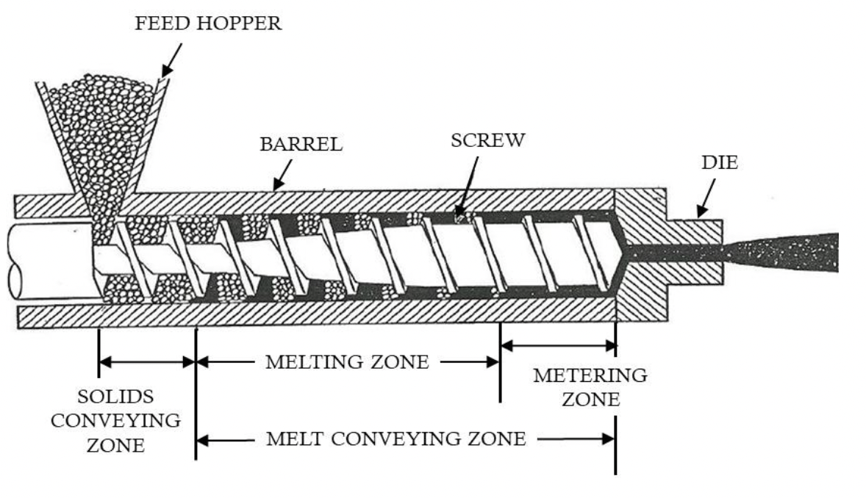
Project Overview
Solution
Filament extruder to process used plastic bottles
3. Vlachopoulus and Polychronopoulus. Understanding Rheology and Technology of Polymer Extrusion. First Edition.
Notes:
Filament extruder: machine that loads up plastic pellets as raw material and processes the pellets into filament that can be used for 3D printing
Existing filament extruders exist with varying price points – most are for more traditional printing plastics like PLA and ABS
PET not traditionally used in 3D printing
Campus wide application: many spaces on campus use filament 3D printing – digital fabrication lab, the wondry, the design studio in FGH, Sybbure, and any student hobbyist
Polyethylene terephthalate – what most soda and sports drinks bottles made of

Slide 5
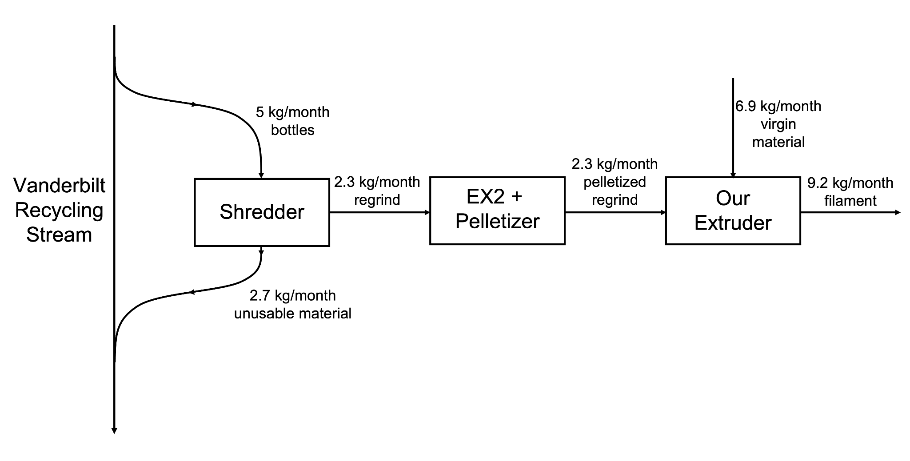
Project Overview
Process Flow Diagram
Notes:
Operating at 3% capacity

Slide 6
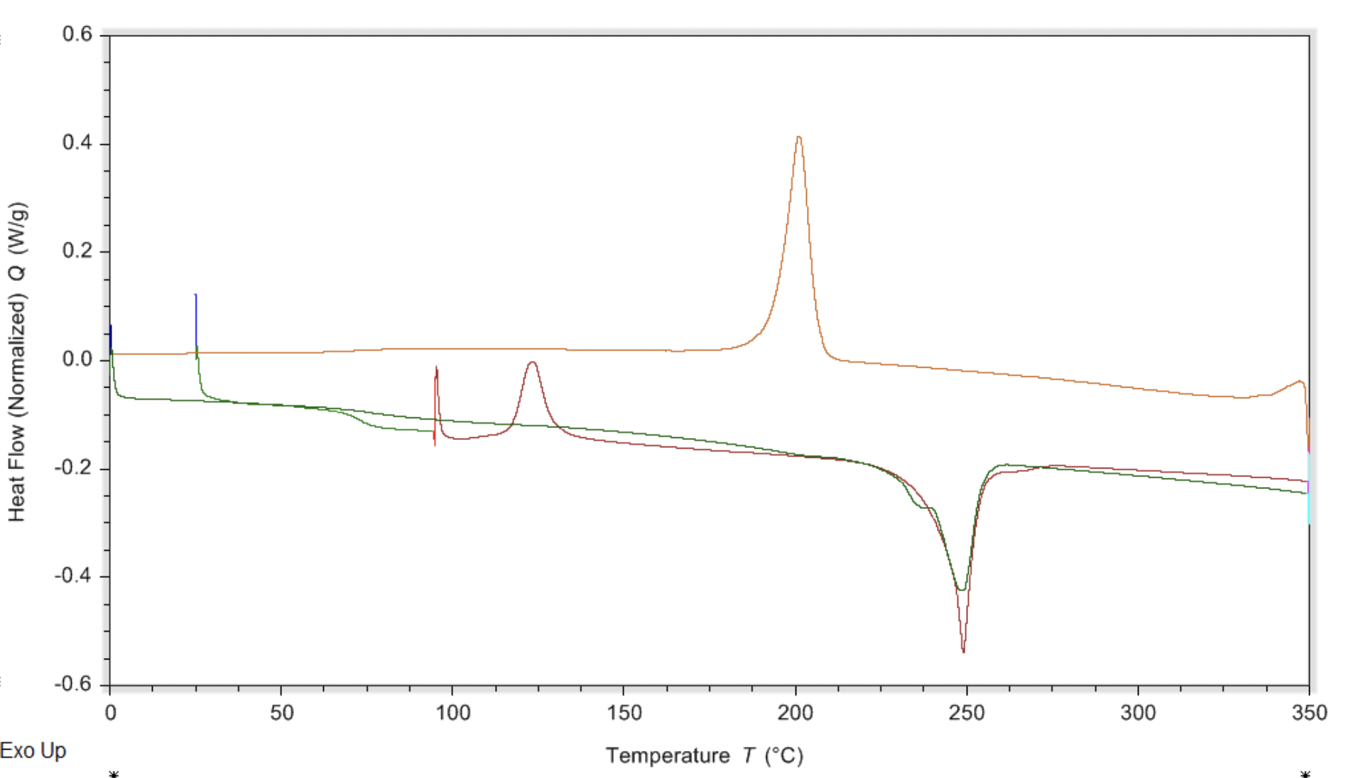
Design Process
Materials Inspection
Performed Differential Scanning Calorimetry on regrind
Coca Cola bottles are approximately 25% recycled content
T_{m, PET} = 260 ℃
T_{m, rPET}= 250 ℃
Notes:
Tc = 247 C
Rework = 25% regrind / 75% virgin pellets

Slide 7
Design Process
Simulation
NEXTRUCAD - polymer extrusion modeling software
Provides key data
Required torque => sizing the motor
Power consumption => process cost
Max Pressure => safety
Result | Value
Output (kg/h) | 1.82
Max Pressure (MPa) | 5.97
Exit Temp (C) | 251.49
Melt Length (D) | 15.64
Power Consumption (kW) | 0.2
Torque (hp) | 0.26
Drag flow cap. (kg/h) | 3.14
Avg residence time (s) | 155.48

Slide 8
Design Process
Economic Viability
“Commercial” Analysis
Selling our filament with extruder operating at max capacity with unpaid undergraduate worker
Annual Profit ~ $8,200
“As needed” Analysis
The Digital Fabrication uses ~ 30 spools of filament a year
Annual Savings ~ $300
Common Market Values
1 kg PETG spool from Amazon - $21
5 kg PETG pellets from Filabot - $56.27
Recycled PET from Vanderbilt - FREE

Slide 9
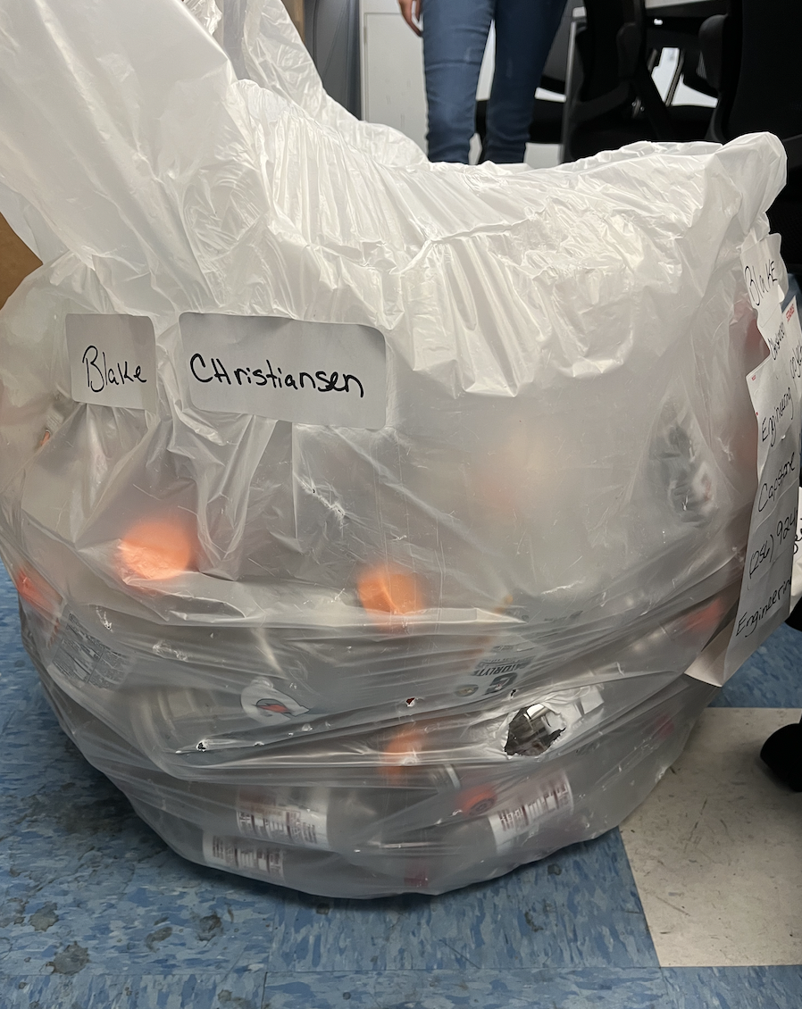
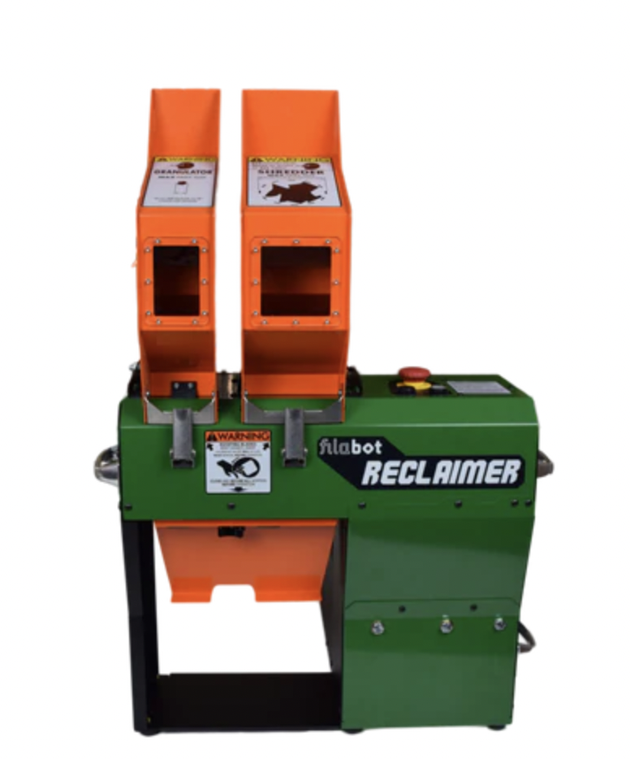
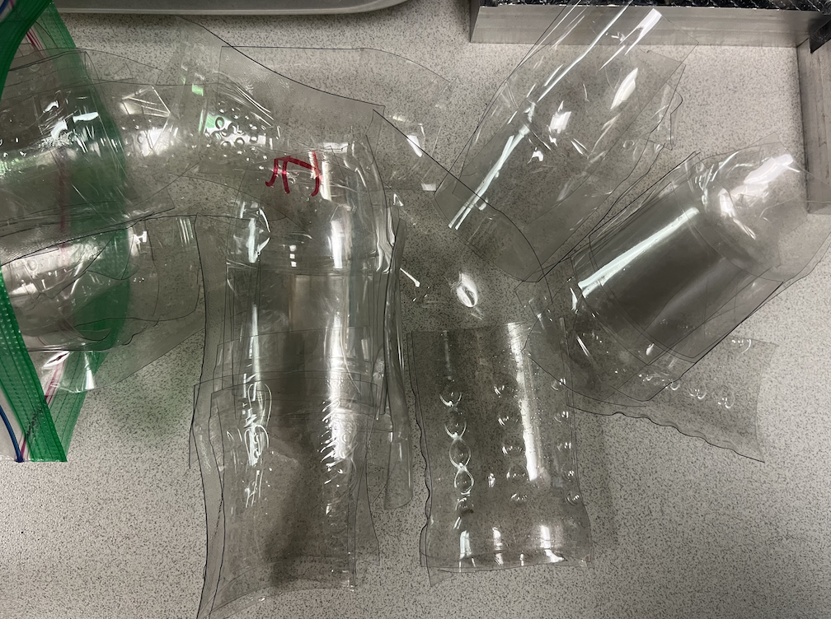
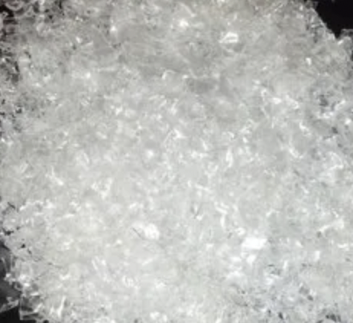
Design Process
Regrind
Partnership with Vanderbilt Recycling Center
Developed method of turning bottles into regrind flake
4. https://www.filabot.com/collections/filabot-core/products/filabot-reclaimer-1
5. https://www.indiamart.com/proddetail/plastic-bottle-flakes-19325769612.html

Slide 10
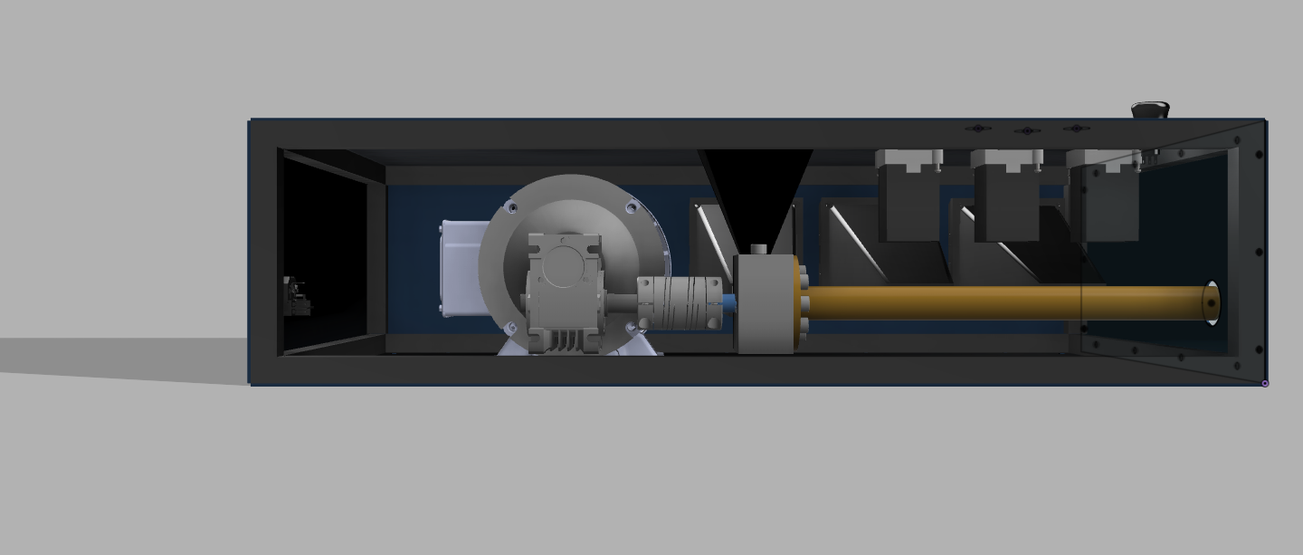
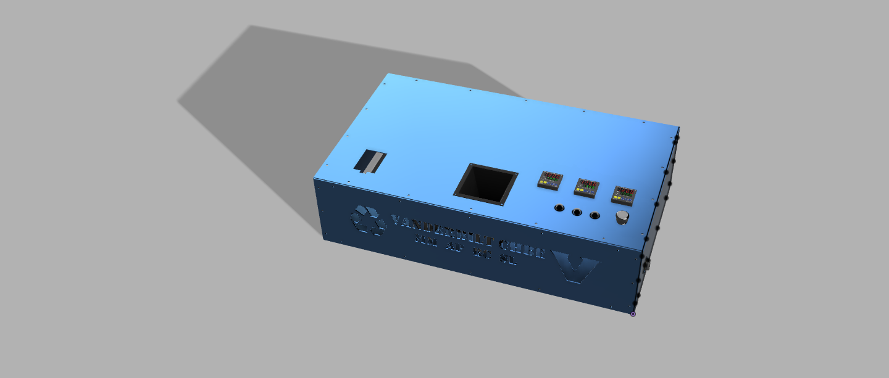

Design Process
CAD

Slide 11
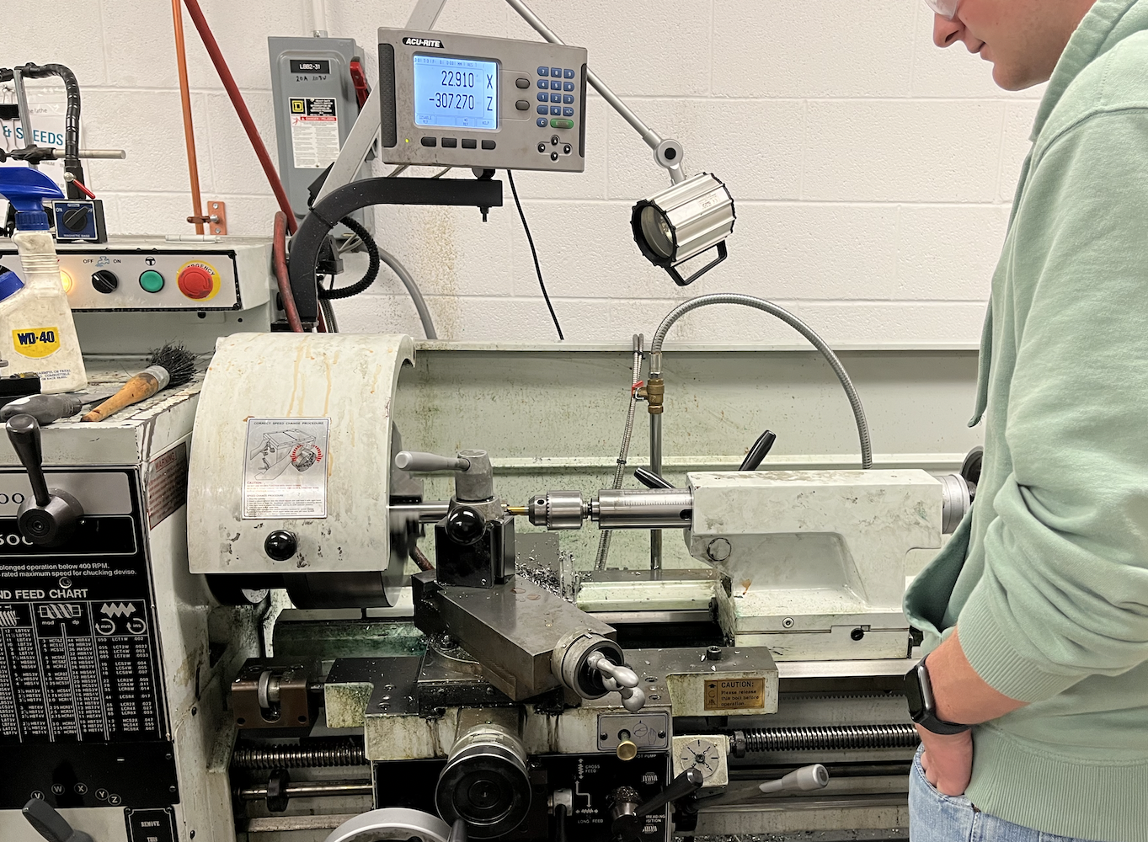
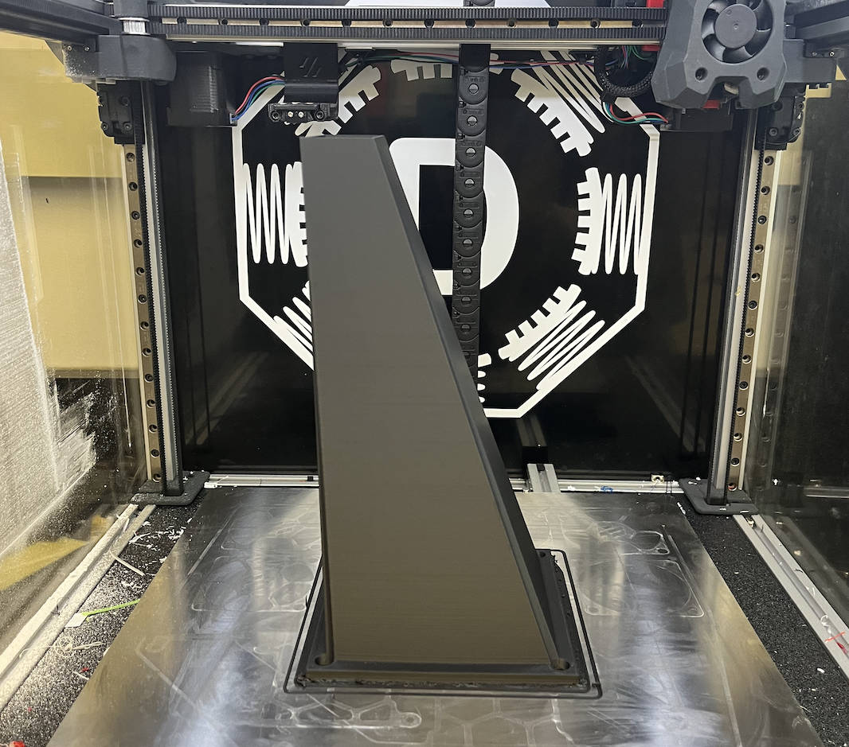
Design Process
Building and Assembly of Extruder
Machined our barrel using the lathe in Olin
Filament 3D printing hopper and fan shrouds
Housing from specialty company, SendCutSend
Acquired remaining parts from McMaster-Carr and Amazon
Self-teaching electrical wiring

Slide 12
Final Remarks
Future Recommendations
Optimize regrind efficiency
Develop method to process more of each bottle
Optimize throughput
Optimize material properties
Notes:
Regrind efficiency – both time and amount if materials recovered per bottle
Throughput – trying conical barrel or grooved barrel
Material Properties – try different ratios of recycled to virgin PET

Slide 13

Final Remarks
Acknowledgements
Immersion Office
Vanderbilt Recycling Center
Dr. Scott Guelcher, Dr. David Florian, Skyler Hornback

